Slide 1
Plural words
Erasmus+Project
LTSDA Cluj-Napoca

Slide 2

Project ID
Project number: KA220-SCH-4780A6CA
Duration: 01/10/2023 - 30/09/2025
Languages: English, Croatian, French, Italian, Polish, Romanian
Program: KA220-SCH - Cooperation partnerships in school education

Slide 3
The project

Slide 4
Goals of the project
Producing and experimenting with innovative and creative tools based on visual factors
Equip the teachers and professionals of education with AAC tools and trainings
To achieve our main goal:
Democratise the learning and teaching of AAC to all learners in early childhood and primary school establishments

Slide 5
Targets of the projects
Kindergarten and primary schools
Public and school libraries
AAC associations
Parents and educators

Slide 6
Results and impacts

Slide 7
Activities of the project
WP1 - Management
WP2 - Methodological framework: A1. Best practices, A2. Pedagogical guide, A3. Pilot AAC boxes and field tests
WP3 - E-learning and training: A1. Self-evaluation quiz, A2. E-learning module, A3. Training workshop and activity
WP4 - AAC boxes: A1. Production of AAC boxes, A2. Pedagogical sheets, A3. White Paper guide
WP5 - Communication, dissemination and exploitation: during the 2 years of the project

Slide 8
Results
AAC boxes – Containing different AAC resources on literacy, numeracy and daily life topic
An E-learning module – To train education professionals on AAC and communication troubles
A pedagogical guide – For early and primary school teachers who would like to become familiar with the fascinating field of AAC
9 pedagogical sheets for professionals – Supporting the implementation of the boxes into daily practice.
A collection of Best Practices – To get inspired from innovative and inspiring organisations, professionals and actions on AAC led in Europe

Slide 9
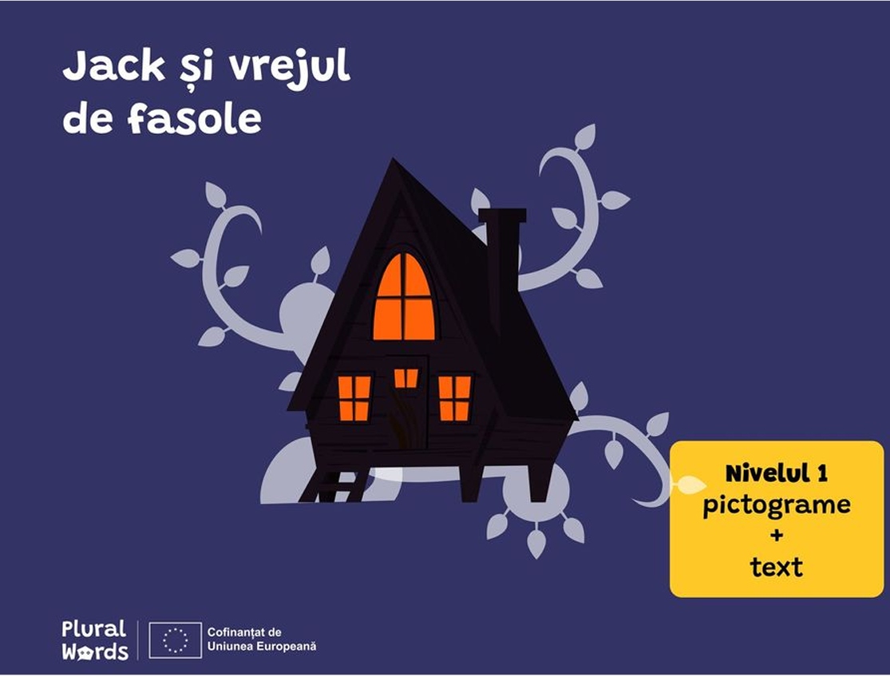
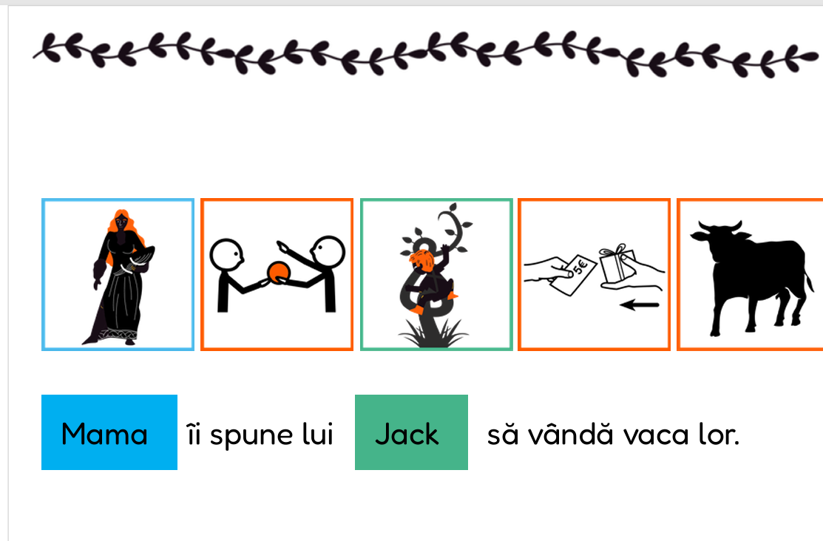
Resources developed: adapted stories

Slide 10
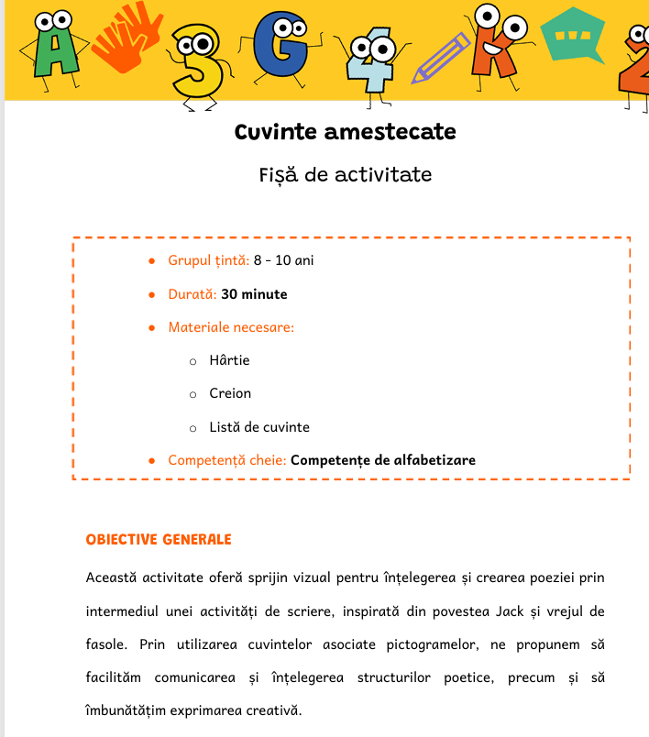
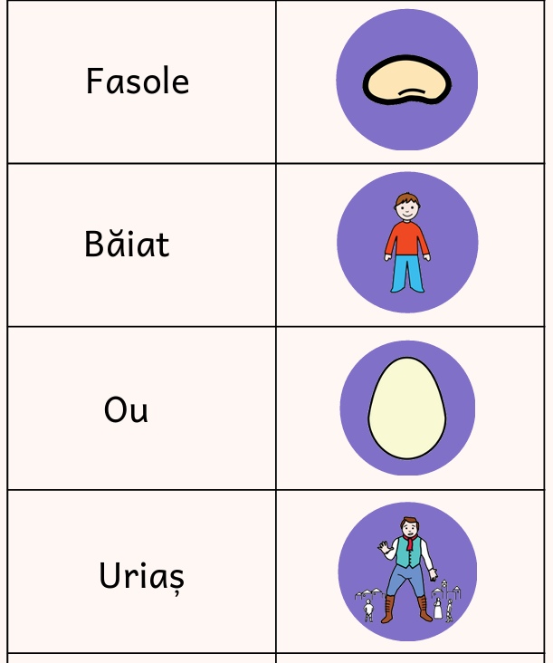
Worksheets and teaching materials

Slide 11
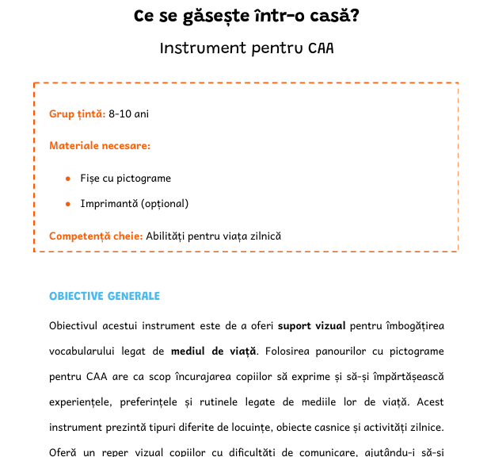
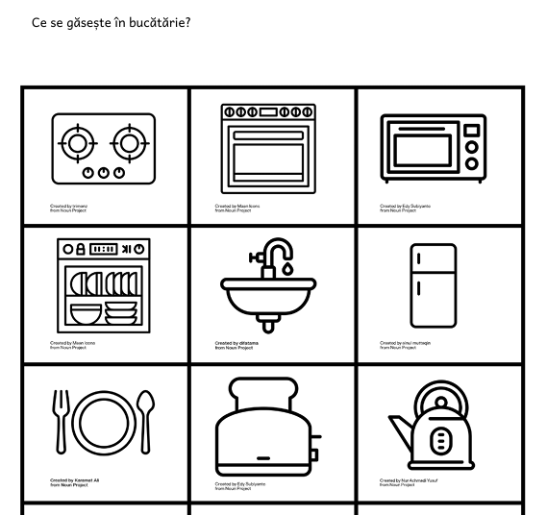
Worksheets and teaching materials

Slide 12
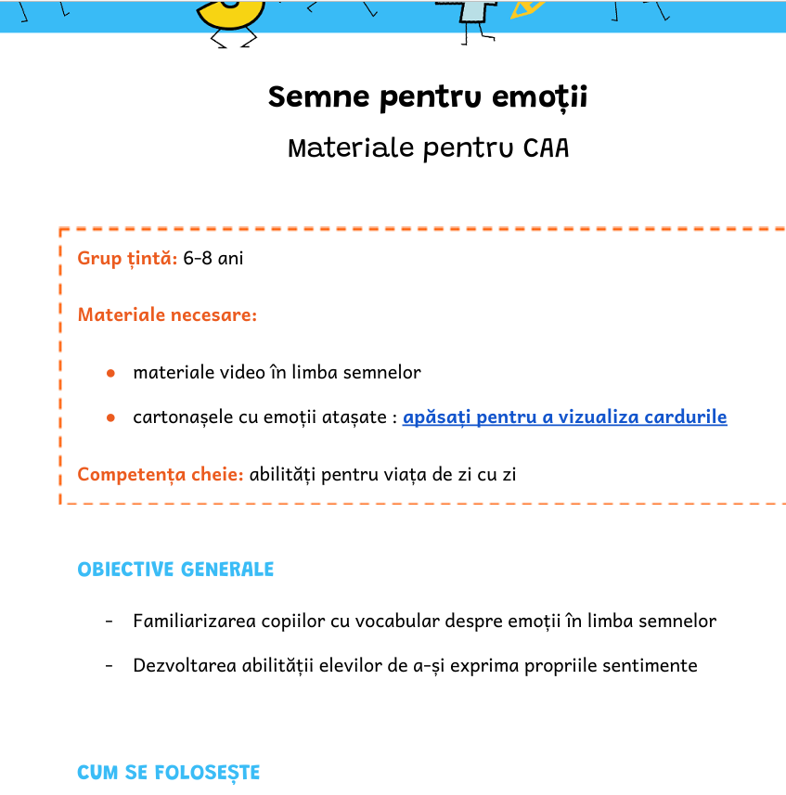
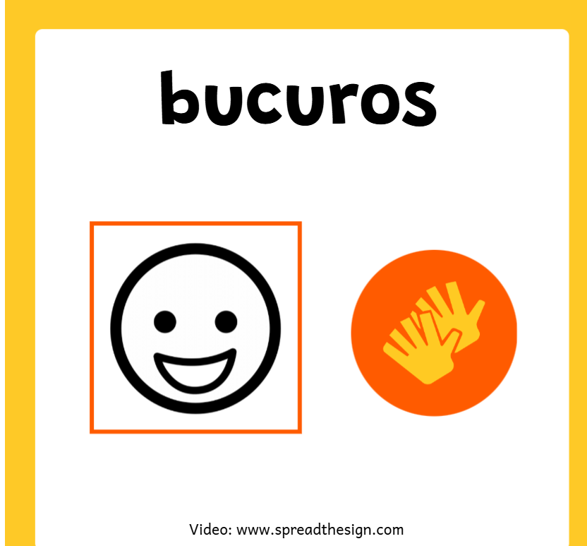
Worksheets and teaching materials

Slide 13
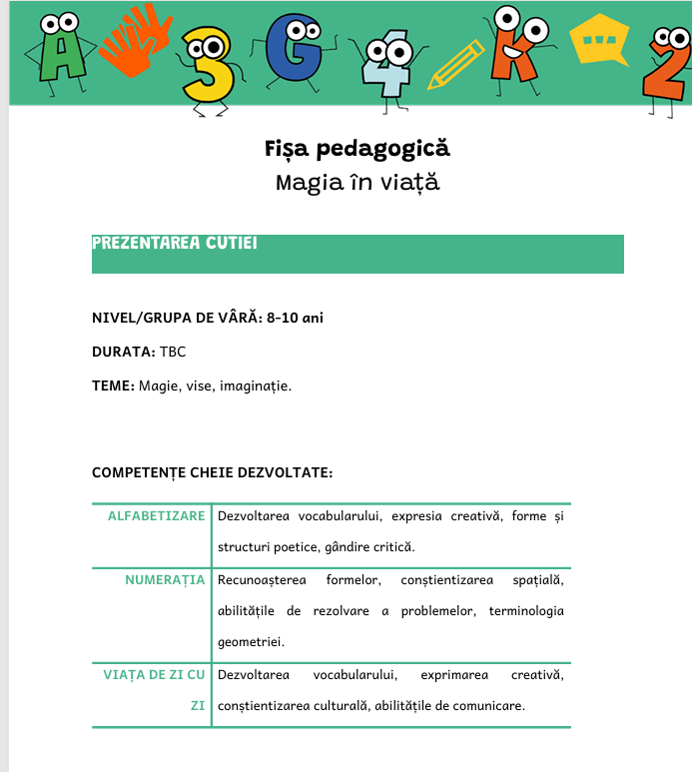
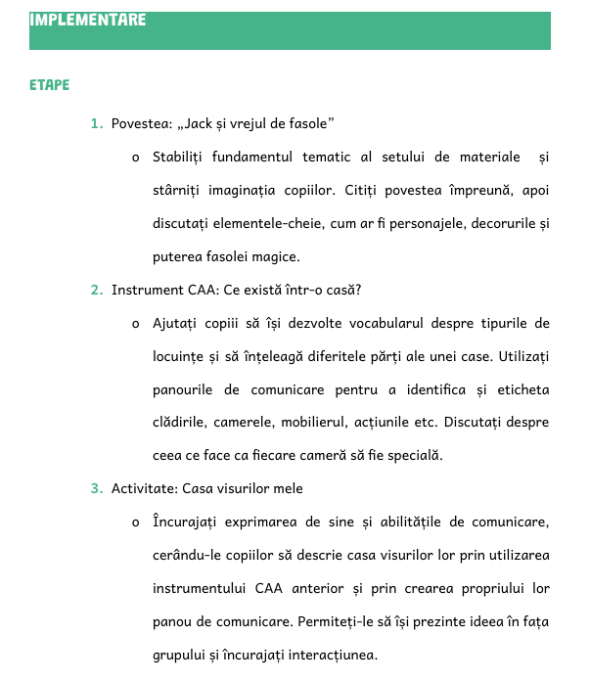
Pedagogical sheets

Slide 14
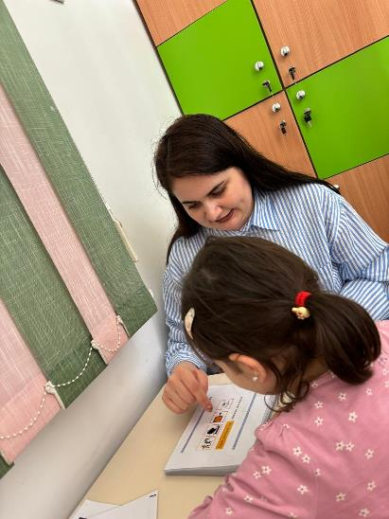
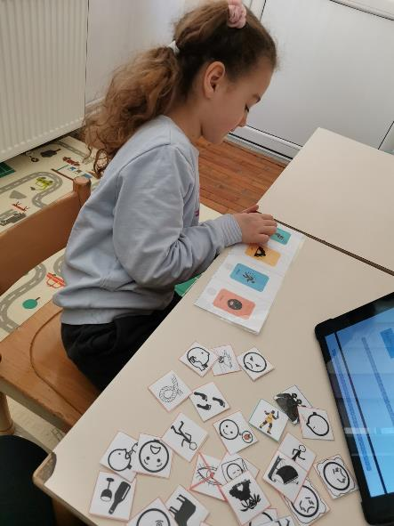
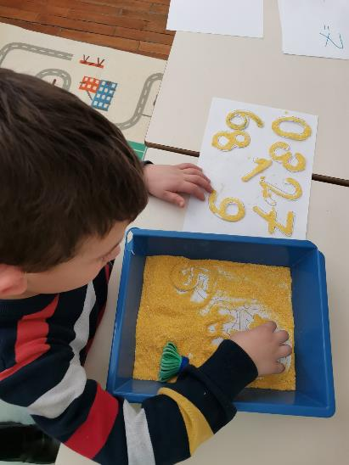
Testing resources in teaching activities - kindergarten

Slide 15
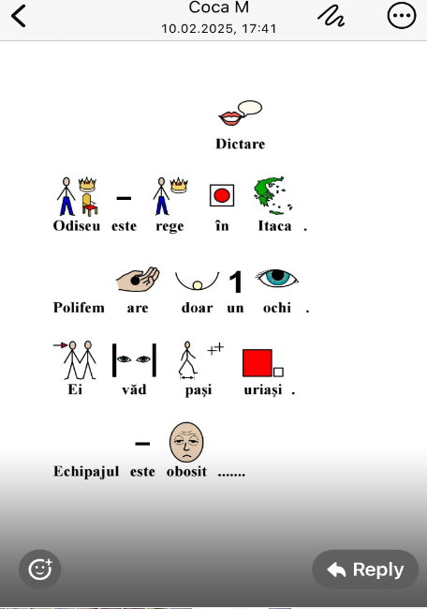
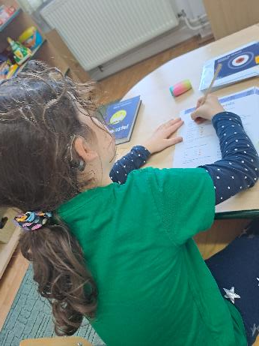
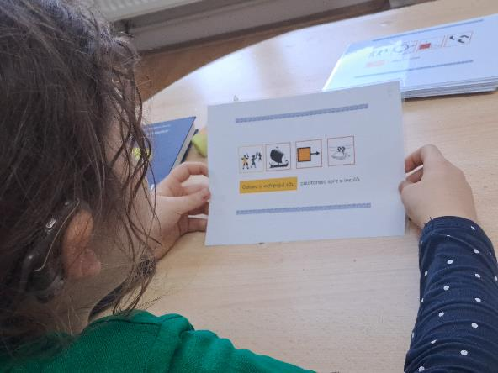
Testing resources in speech therapy activities- CSFRT

Slide 16
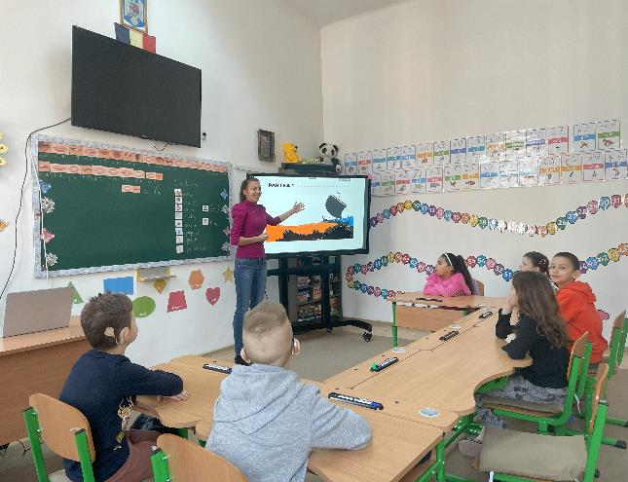
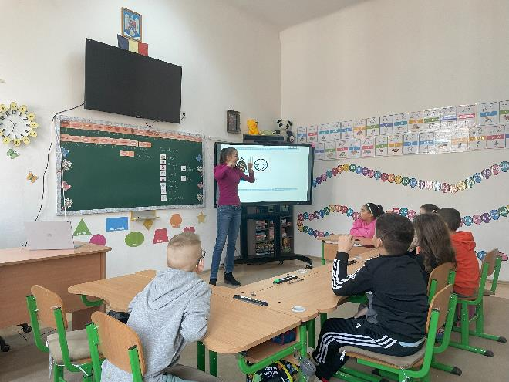
Testing resources in teaching activities – primary school

Slide 17
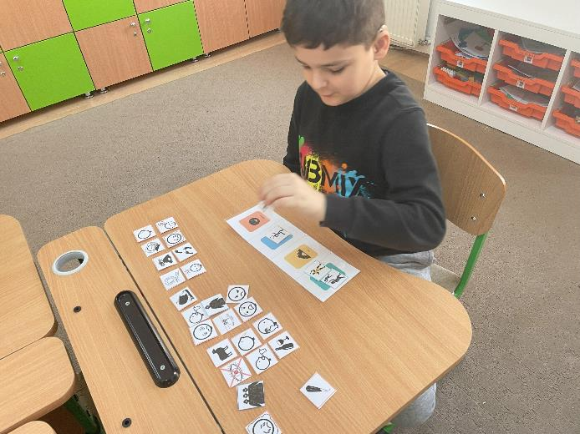
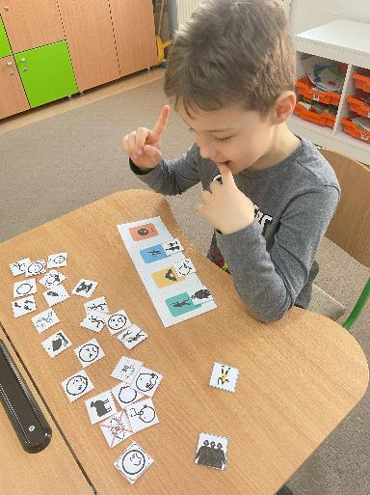

Slide 18
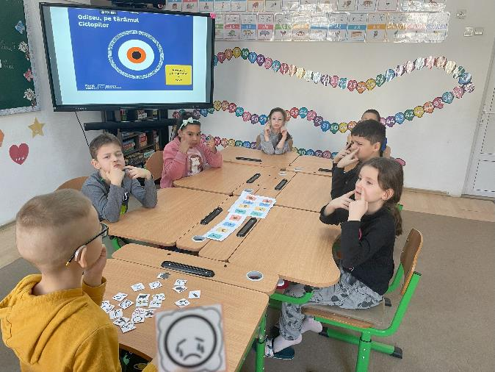
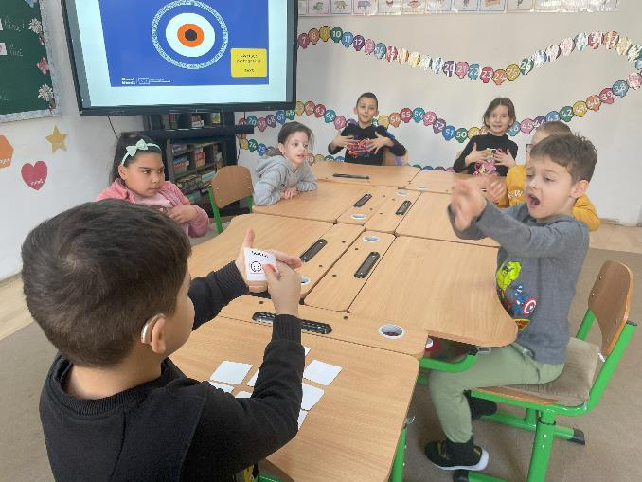

Slide 19
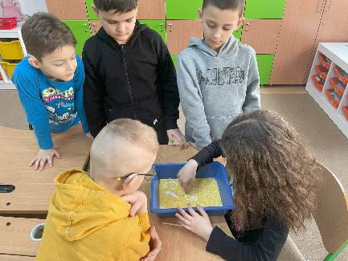
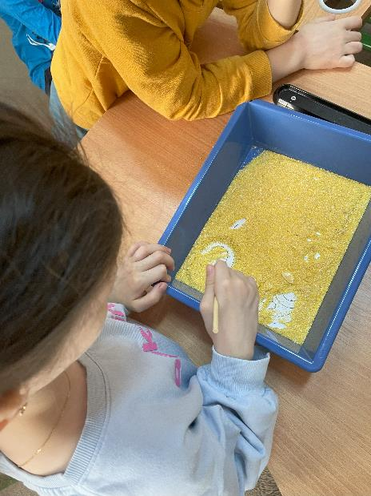
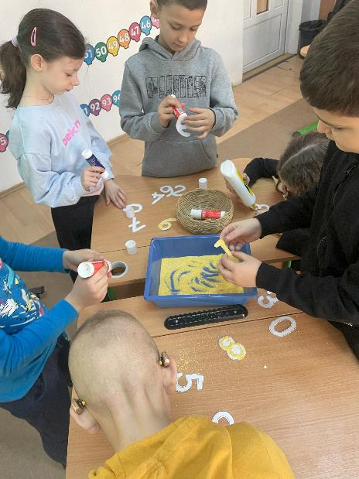
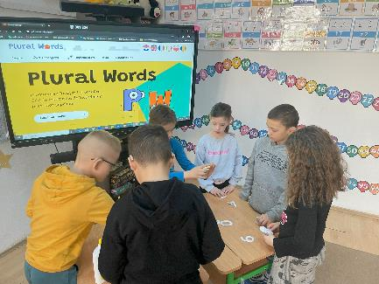

Slide 20
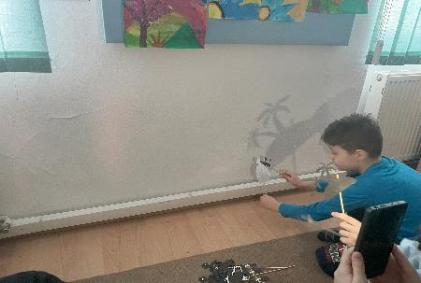
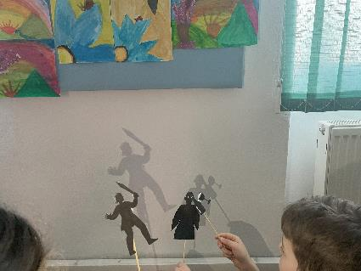
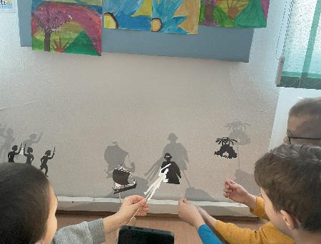
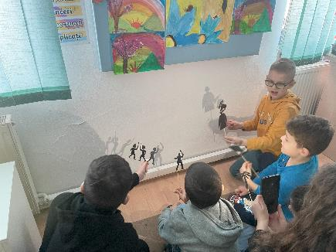

Slide 21
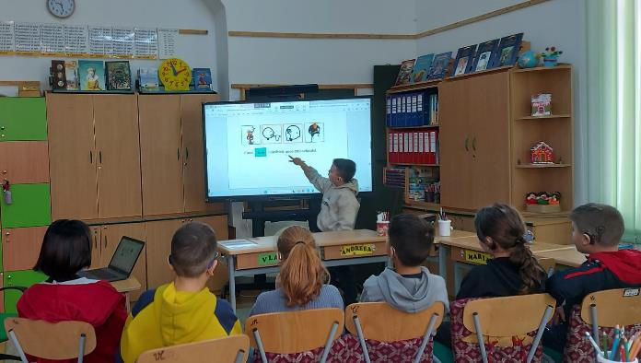
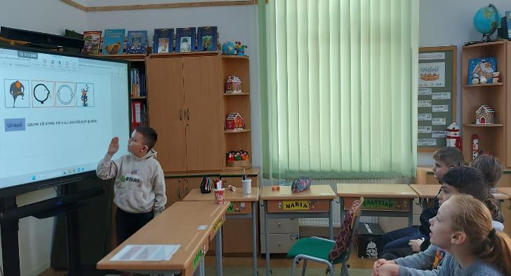
Testing resources in teaching activities – primary school

Slide 22
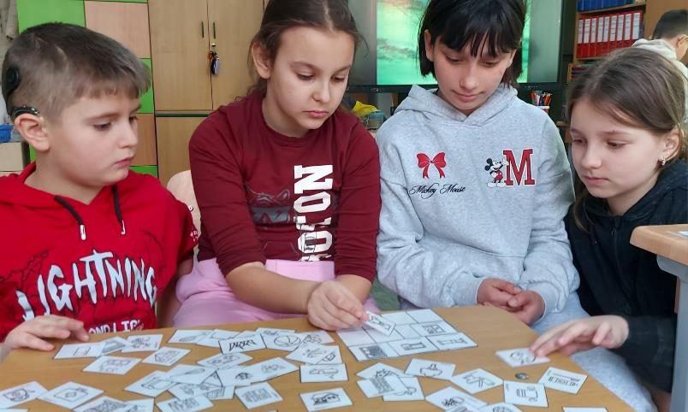
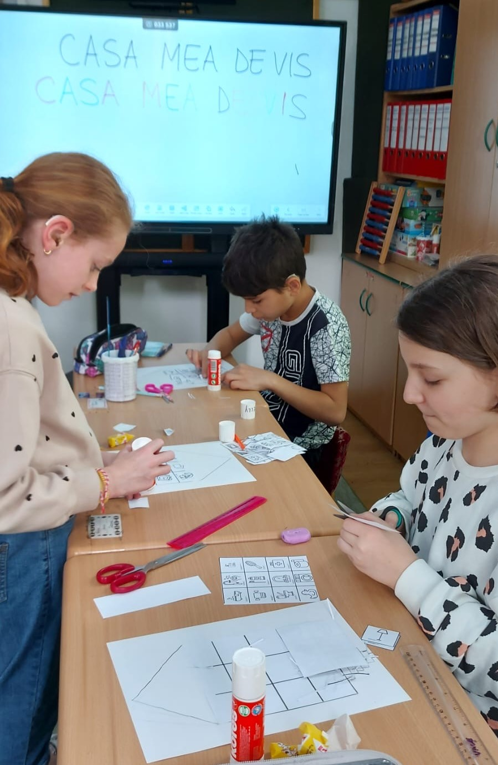
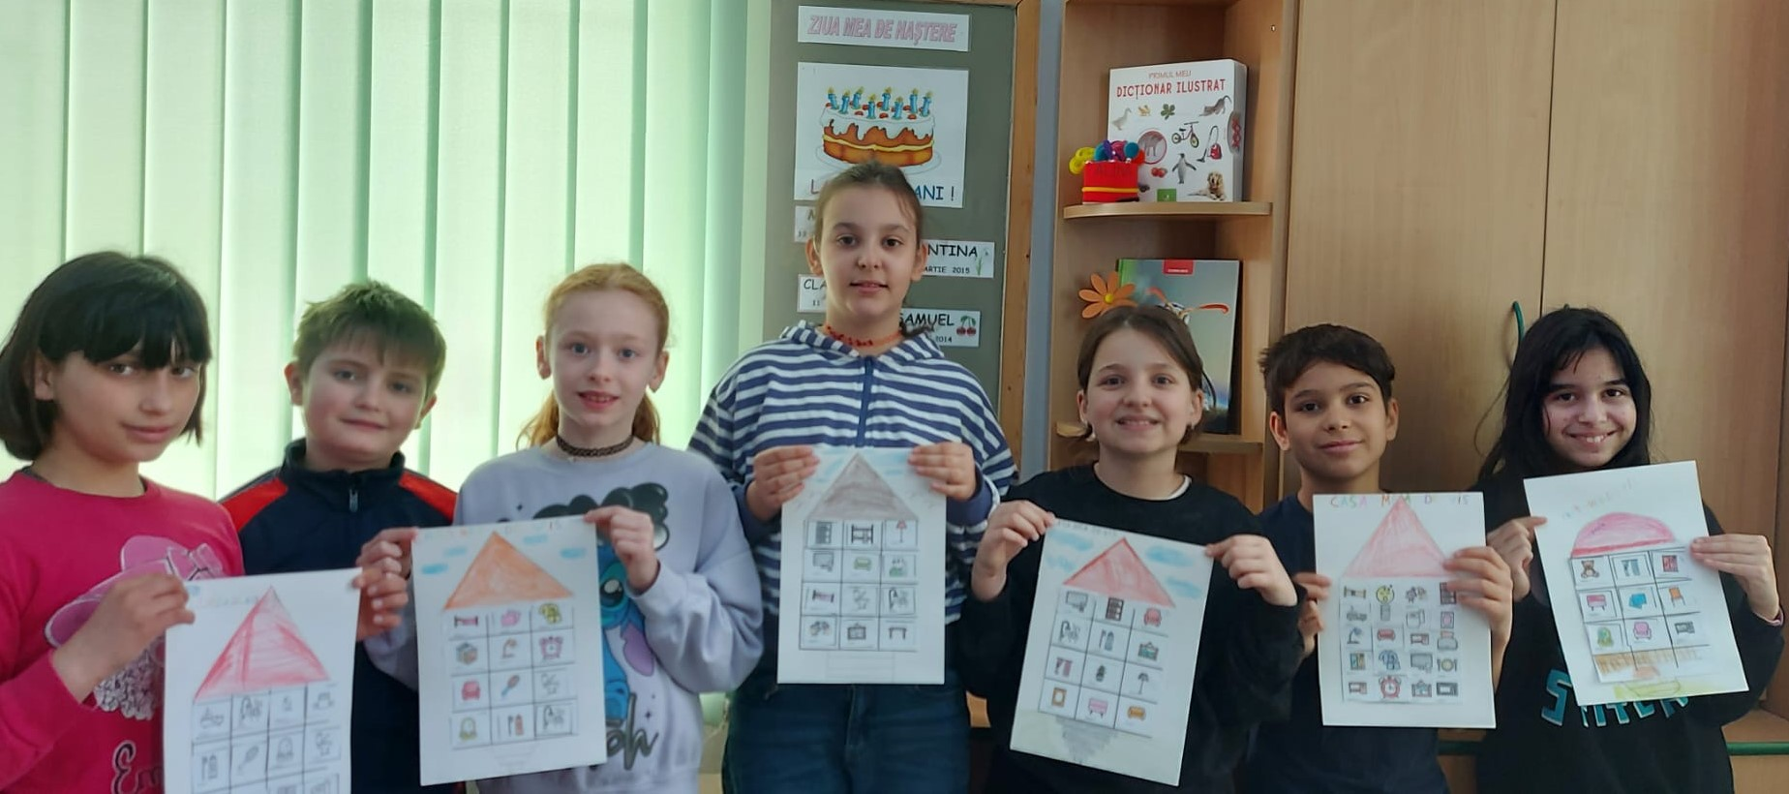

Slide 23
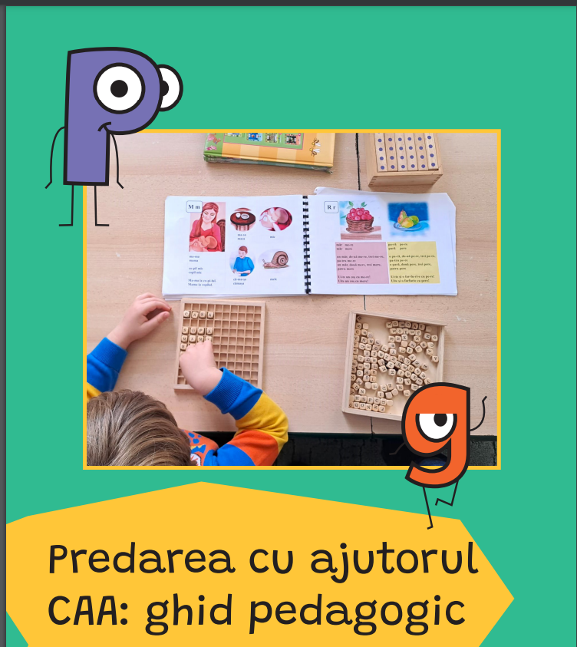
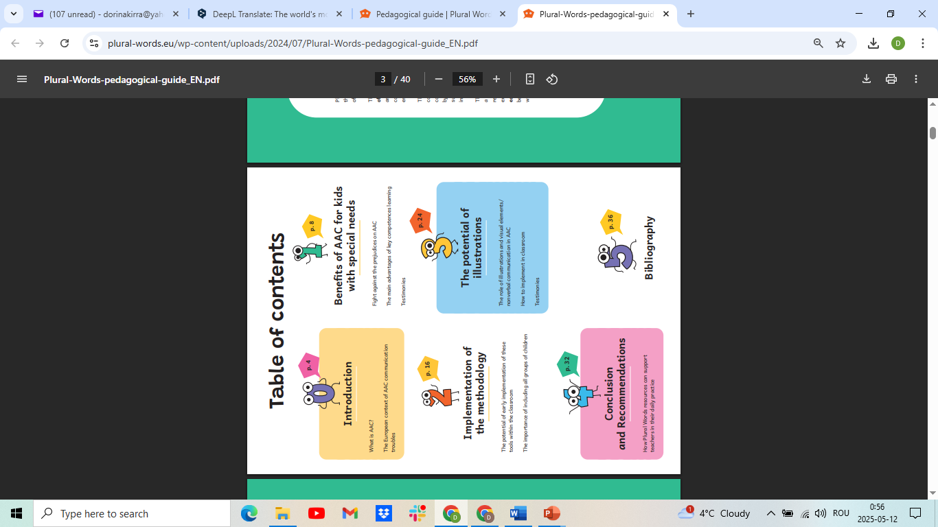
Pedagogical guide

Slide 24
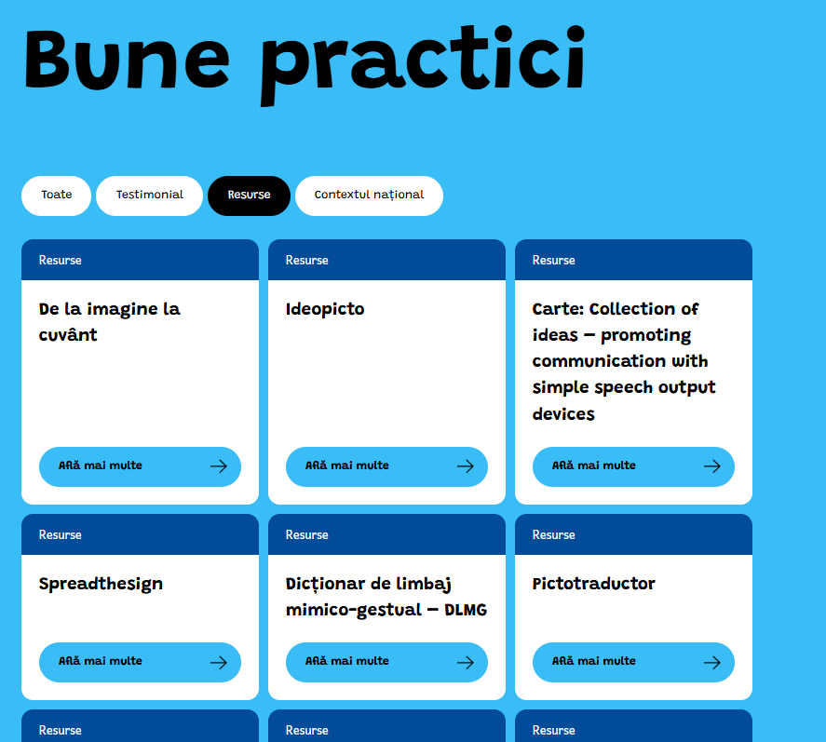
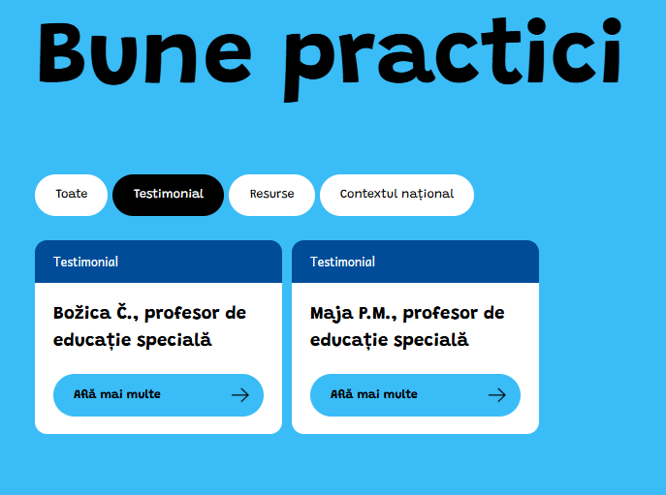
European good practice examples: resources, testimonials

Slide 25
Main impacts
For the partners:
to equip teachers and education professionals with truly inclusive tools that guarantee an acquisition of key competences for all children within the school environment
to have an impact on the democratisation of alternative ways of communication
to advocate and speak positively of AAC methods and pedagogy outside the partnership
In the medium and long term (outside the partnership):
a modification of perception on AAC and communication disorders
an evolution of training tools used within the classrooms for the acquisition of key competences and inclusive practices
capacity of professionals to engage into inclusive and alternative pedagogies
internationalisation of associated organisations and participants

Slide 26
Website

Slide 27
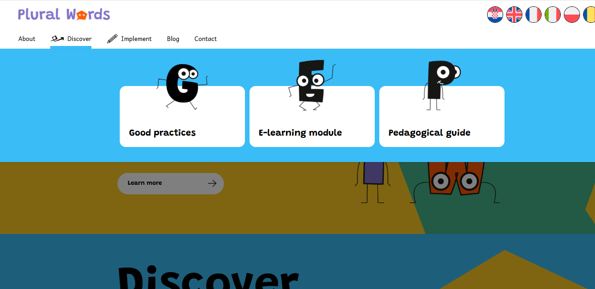
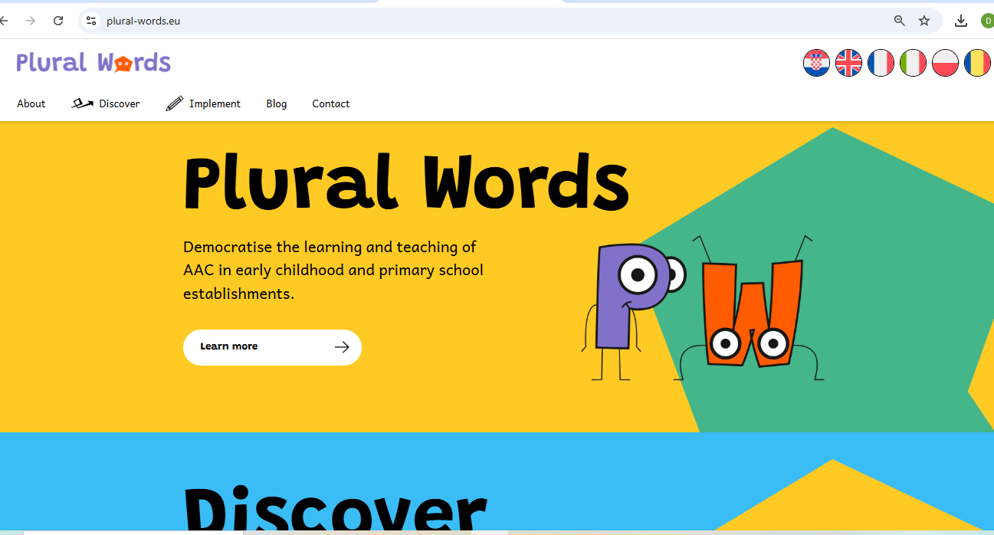
https://plural-words.eu

Slide 28
Thank you!

